Slide 1

Timeless Treasures Watches Website
Darshan YN-23BTRE113
Manohar k-23BTRE123
Rakesh-23BTRE135
Tejas- 23BTRE148

Slide 2
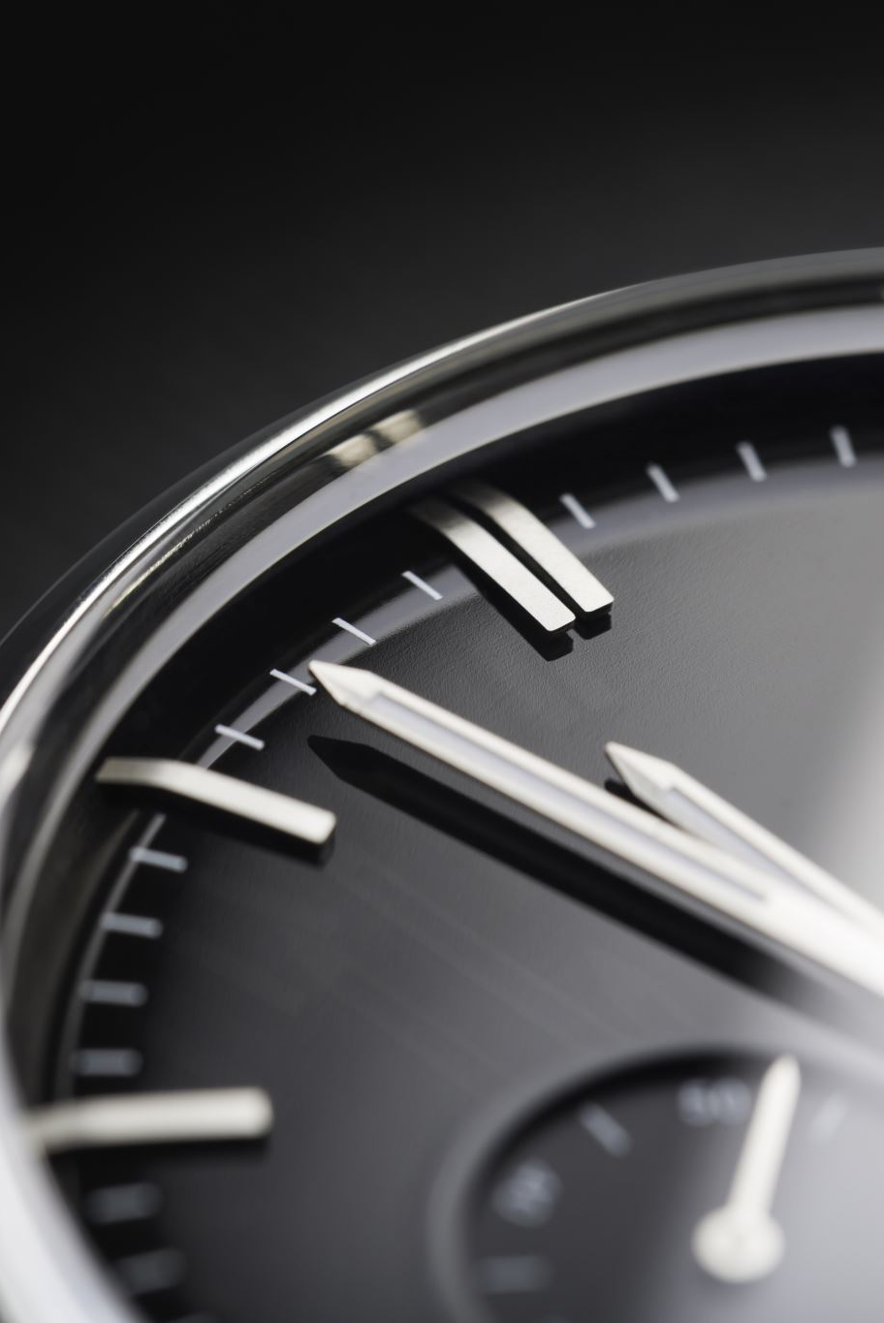
Introduction
This website is a responsive e-commerce platform designed for showcasing and selling watches.
It includes various sections such as featured products, new arrivals, and detailed product pages.
The website aims to provide a seamless shopping experience with a focus on aesthetics and usability.

Slide 3
Content
Key sections of the website:
Home: Overview of featured products and promotions.
Products: Detailed product listings with descriptions, prices, and images.
About: Information about the brand, its history, and values.
Contact: Contact form and company contact details.
Additional sections include a newsletter signup and customer testimonials.

Slide 4
Design and Layout
The website features a modern and clean design with intuitive navigation.
It is built using HTML, CSS, and JavaScript, ensuring responsiveness across different devices.
The layout is optimized for both desktop and mobile viewing, providing a consistent user experience.

Slide 5

Technologies Used
The website is developed using the following technologies:
HTML5: Structure and content of the website.
CSS3: Styling and layout, including Flexbox and Grid.
JavaScript: Interactivity and dynamic content.
Swiper.js: Responsive sliders for featured and new products.
These technologies ensure a robust and engaging user experience.

Slide 6

Features and Functionality
The website includes several key features:
Responsive design: Optimized for all devices.
Product filtering: Easy navigation through product categories.
Shopping cart: Simple and efficient checkout process.
Animations: Smooth transitions and hover effects.
These features enhance the overall shopping experience for users.

Slide 7

Conclusion
This responsive watches website provides an excellent platform for showcasing products with a user-friendly design and comprehensive content.
It is an ideal solution for an e-commerce business.
The use of modern technologies and thoughtful design ensures a high-quality user experience.

